Slide 1








Easy to use and interpretable model
based on artificial intelligence
for predicting 5-year weight trajectories after bariatric surgery
Patrick Saux, Pierre Bauvin, Julien Teigny, Violeta Raverdy, Helene Verkindt, Guelareh
Dezfoulian, Mihaela Moldovanu, Severine Andrieux, Julien Couster, Marie Lepage,
Anne Jacobs, Daan Jacobs, Valerie Monpellier, Florence Galtier, David Nocca, Robert
Caiazzo, Philippe Preux, Francois Pattou.

Slide 2
Conflict of Interest
Patrick Saux
I have nothing to disclose...

Slide 3

Conflict of Interest
Patrick Saux
I have nothing to disclose...
… except I am not from medical sciences.

Slide 4

Conflict of Interest
Patrick Saux
I have nothing to disclose...
… except I am from mathematics!

Slide 5





Outcome
Roux-en-Y Gastric Bypass
(RYGB)
Total Weight Loss (%TWL)
→ between preop and follow-up visits
(12, 24, 60 months post-op)
→ continuous outcome in %
Sleeve
Gastrectomy (SG)
Adjustable Gastric Band
(AGB)

Slide 6





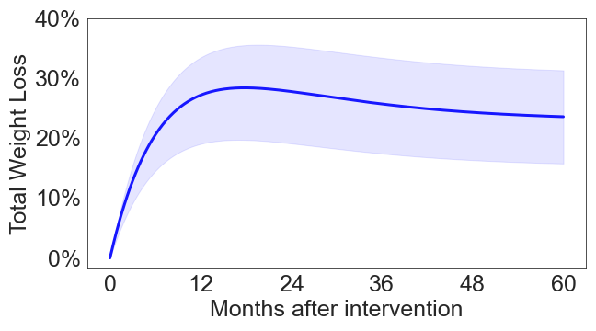
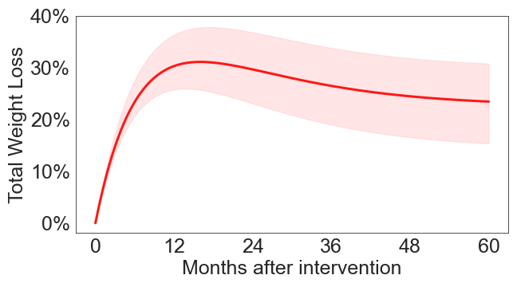
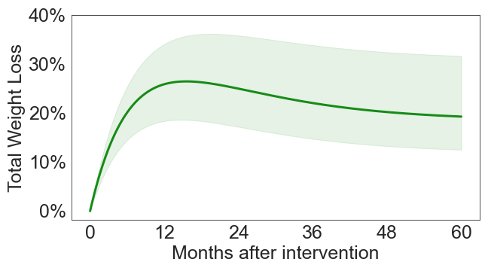
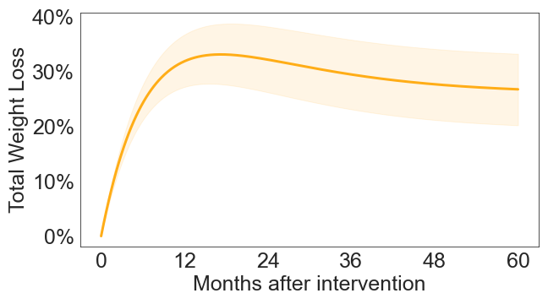
ABOS
Montpellier
PRECOS
NOK
Prospective cohort
N=1,147
RYGB, SG, AGB
1370 attributes at baseline
N=348
SG
N=237
RYGB, SG, AGB
N=5,697
RYGB, SG, AGB

Slide 7
ABOS
Montpellier
PRECOS
NOK
Derivation cohorts
Validation cohorts
Prospective cohort
N=1,147
RYGB, Sleeve, AGB
N=348
Sleeve
N=237
RYGB, Sleeve, AGB
N=5,697
RYGB, Sleeve

Slide 8




Weight Loss Predictive Model
`
Preprocess
LASSO
Regression Tree
Testing
Cleaning, imputation
Visit date adjustment
Extract most predictive features
Validated by clinicians
Stratification of patients
Interpretable
Root Mean Squared Error (RMSE)
Inter-Quartile Range (IQR) prediction interval
Feature
extraction
Preprocessing
Calibration
Validation

Slide 9
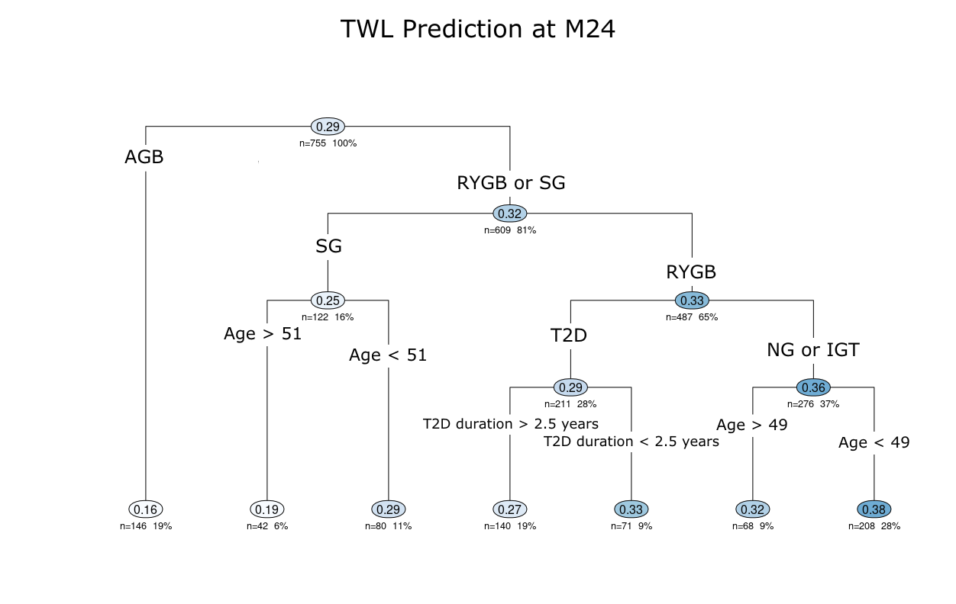
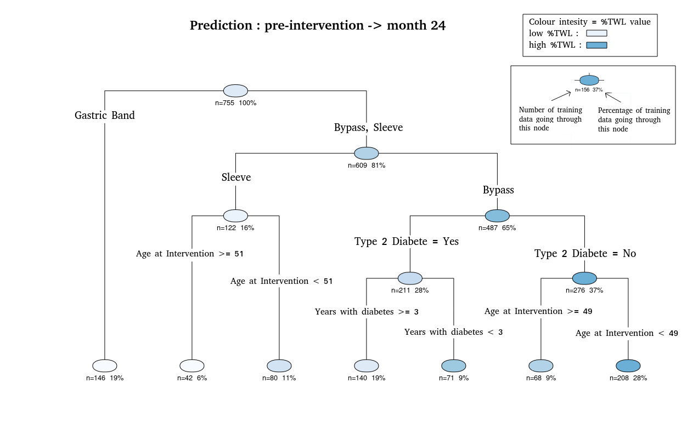
TWL Prediction at M24
Results as of December 2021.
T2D: type II diabetes.
IGT: impaired glucose tolerance.
NG: normoglycemic.

Slide 10
Validation Results
Testing literature model in ABOS cohort
Model | Month | Operation | n | RMSE
Cottam2 | 12 | SG | 232 | 4.8
Velazquez1 | 12 | RYGB | 741 | 4.0
Wise | 12 | RYGB | 686 | 4.7
Goulard | 12 | SG | 232 | 5.9
Seyssel1 | 12 | RYGB | 744 | 4.0
Janik | 12 | SG | 232 | 5.1
Baltasar2 | 24 | RYGB + SG + GB | 1098 | 7.0
Baltasar3 | 24 | RYGB | 684 | 5.3
Baltasar4 | 24 | SG | 191 | 7.5
Velazquez2 | 24 | RYGB | 684 | 5.0
Seyssel2 | 24 | RYGB | 684 | 5.1
Seyssel3 | 60 | RYGB | 398 | 5.9
Regression Tree Model
 | At 12 months | At 24 months | At 60 months
Internal test data (n=230) | 3.9 | 4.7 | 4.8
External validation data (n=5,934) | 3.3 | 4.1 | 4.8
Literature models | 4.0 - 5.9 | 5.0 - 7.5 | 5.9

Slide 11
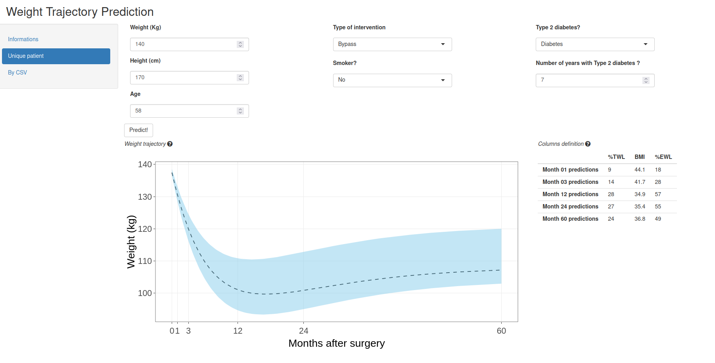

Slide 12
Patient attributes
Can be used at home/during visit

Slide 13
Dashed line: expected trajectory for a “standard” patient
Shaded area: “reasonable” deviation from expected (IQR)

Slide 14
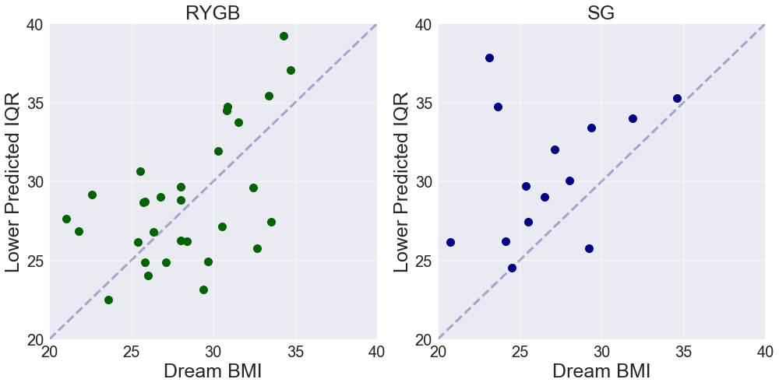
Application: managing expectations
81 patients at CHU Lille
Subjective “dream weight” provided during pre-op visit.
→ Dream weights are often outside of IQR.

Slide 15
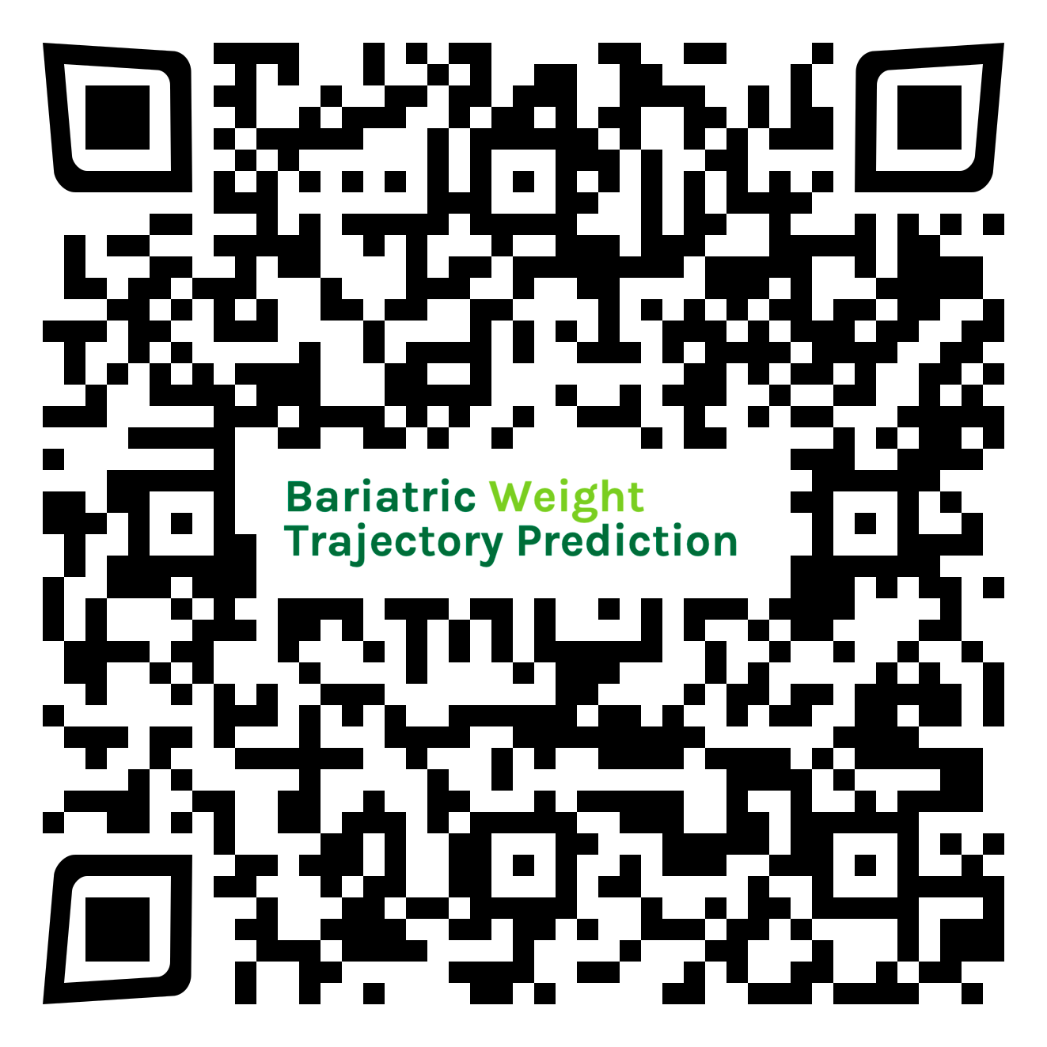
Online Weight Trajectory Prediction Tool
https://bwtp.univ-lille.fr/

